Slide 1
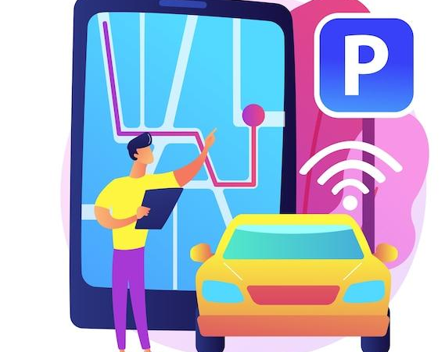
Smart Parking: An IoT Based Solution for Smart University
Presented by
JU34_

Slide 2
Outline
1
2
3
4
Introduction
Problem Statement
Literature Review
Existing System vs Proposed System
5
6
7
8
Project Planning
Components
& Budget
Components Description
Methodology (Workflow, Circuit Diagram, Steps
9
10
11
12
Obtained Output
Future Work &
Limitations
Conclusion
References

Slide 3
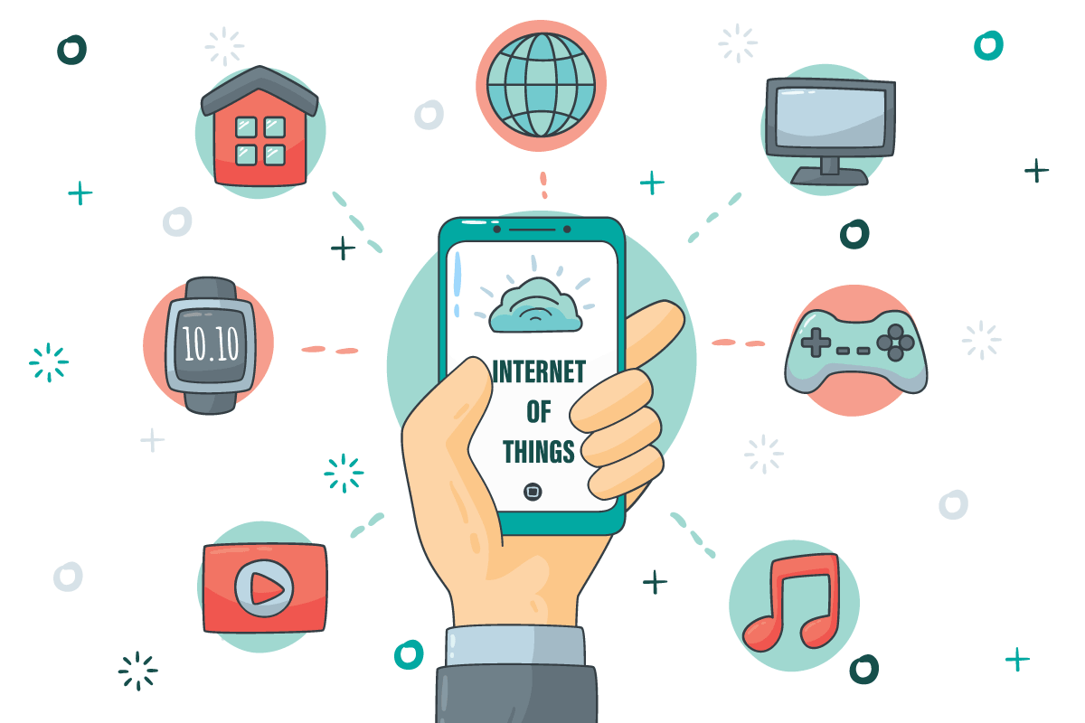
Introduction
In response to the growing challenges of parking on university campuses, our project proposes a cutting-edge solution: "Smart Parking."
With the power of the Internet of Things (IoT), our innovative system aims to streamline and optimize parking spaces, providing a hassle-free and efficient parking experience for students, faculty, and staff.
With real-time monitoring and smart technology integration, Smart Parking is designed to revolutionize parking management at our university.

Slide 4
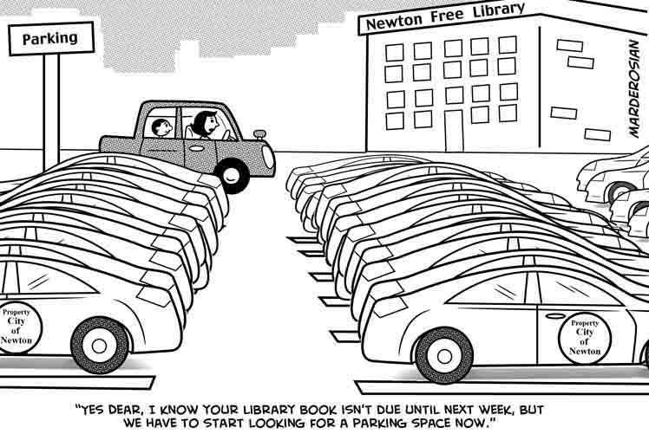
Problem Statement
In the dynamic environment of a university campus, managing parking spaces efficiently can be a daunting task.
The traditional approach to parking management often leads to congestion, frustration among students, faculty, and visitors, and inefficient space utilization.
To address these challenges, there is a pressing need for a smart solution that optimizes parking space allocation, enhances user experience, and integrates seamlessly with the university's existing infrastructure.

Slide 5

Literature Review
"IoT-based Smart Parking System: " by CHINT Global (2020) highlights the advantages of IoT-based parking systems, including real-time monitoring, improved space utilization, and enhanced user experience.
"Cloud-Enabled IoT-based Smart Parking System: Design and Implementation" by A Khanna et al. (2016) utilizes wireless sensor networks and cloud computing to automate parking management processes and optimize resource allocation.
"Integration of IoT and Cloud Computing for Smart Parking Applications:" by Hardik Tanti et al. (2018) explores the integration of IoT and cloud computing technologies for smart parking applications through a case study.

Slide 6
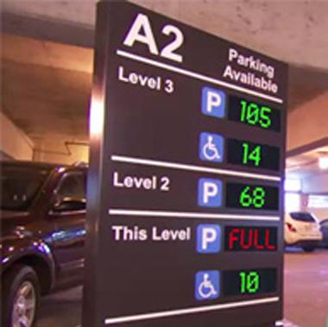
Existing System
The problem in the existing system is whether parking slot is available or not doesn't know before reach the parking area.

Slide 7
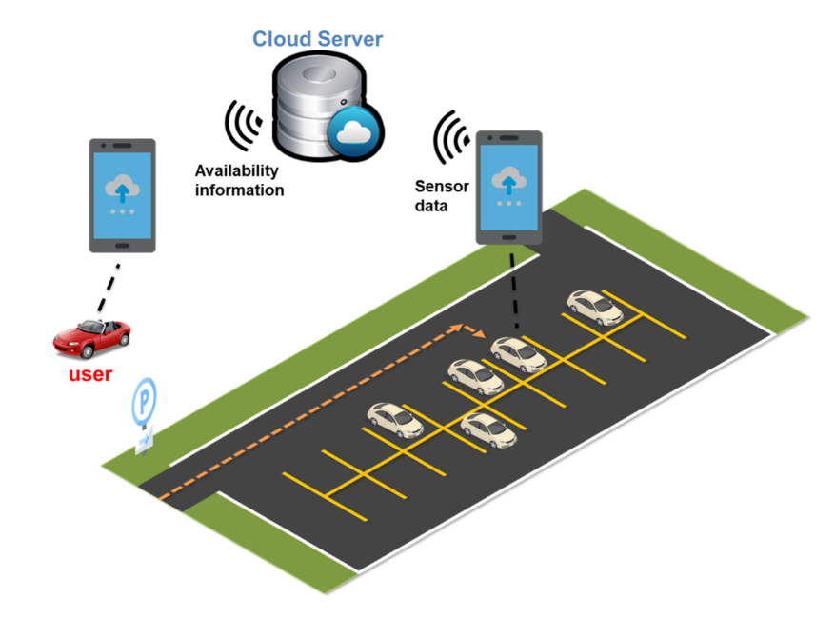
Proposed System
To find the available parking space from anywhere
By using mobile application and web application

Slide 8


Project Planning
Implementation of the proposed system.
To study Software & Hardware components.
Experimental setup of proposed design
Result & Discussion.
Checking output by writing the appropriate code.

Slide 9

Components & Budget
Components | Quantity | Rate | Total ( BDT)
NodeMCU ESP8266 | 1 | 404 | 404
IR Sensor | 4 | 90 | 360
Servo Motor | 2 | 150 | 300
Jumping Wires | 1 set | 140 | 140
Bread Board | 1 | 150 | 150
USB cable | 1 | 190 | 190
Toy cars | 3 | 30 | 90
LCD Display 16x2 | 1 | 255 | 255
Plywood Board Sheets | 10 pcs set | 800 | 800
Others |  |  | 1600
 |  | Total= | 4289
Hardware:
We have purchased all components from TechshopBD ,Daraz, Robiul Electronics and local shops.
Additional components for designing the layout of the project includes: Paper boards, color papers, colors, glue guns, brushes, scissors, anti-cutter etc.

Slide 10
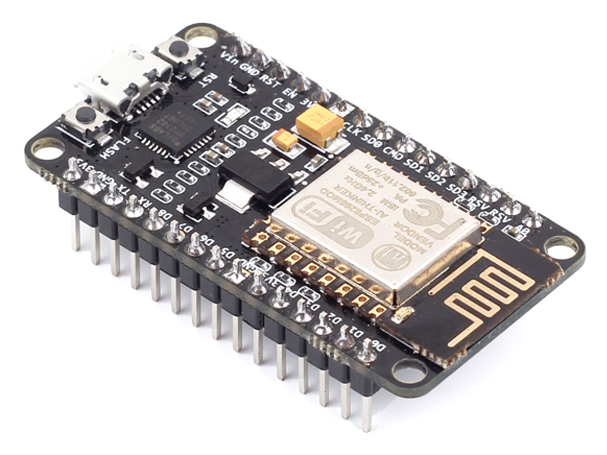
NodeMCU ESP8266
Connects to the Internet Wirelessly
Easy to Program
Works with Many Sensors and Gadgets
Small and Affordable
Can Be Programmed in Different Ways
Connectivity: Wi-Fi, Bluetooth
Power and Programming: Micro USB

Slide 11
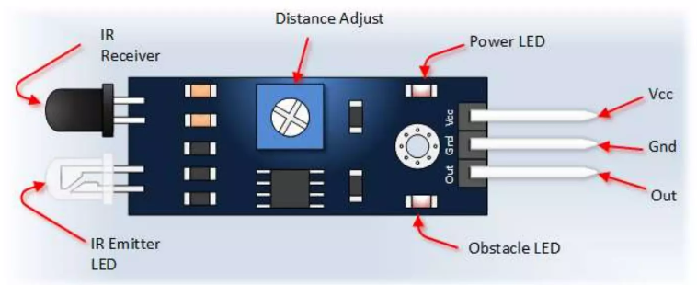
IR Sensor
Detects infrared radiation.
Used in object detection
Applications in motion sensing and security systems.
Measures surface temperature without contact.

Slide 12
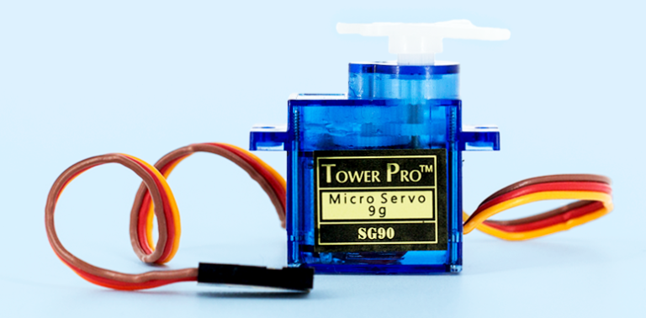
Servo Motor
Servo motors are used to lift the gates at the entry and exit of the parking area.
High Torque at High Speeds
Compact, Lightweight Design
Available in Various Sizes and Power Ratings

Slide 13
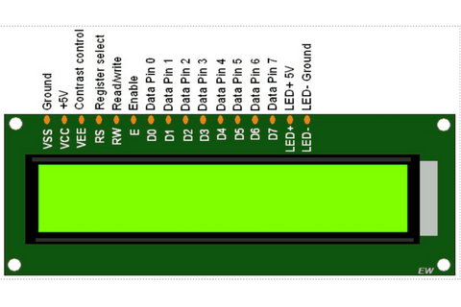
LCD Display
A 16x2 LCD display is very basic module and is very commonly used in various devices and circuits.
A 16x2 LCD means it can display 16 characters per line and there are 2 such lines.

Slide 14


Cloud(Blynk)
Blynk empowers creators to seamlessly control and monitor their projects from anywhere, with its user-friendly interface and powerful IoT platform.
It utilizes both mobile app and web app

Slide 15
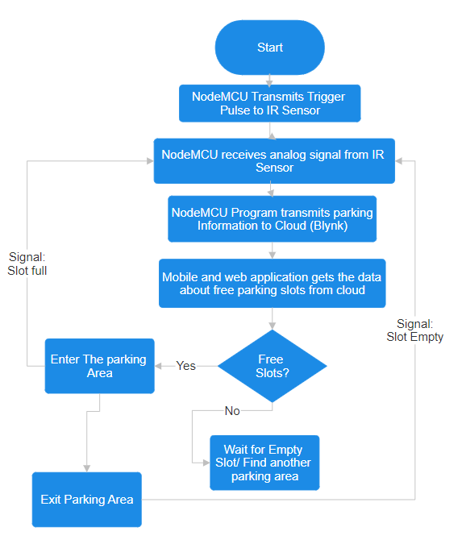

Methodology (Work Flow)

Slide 16
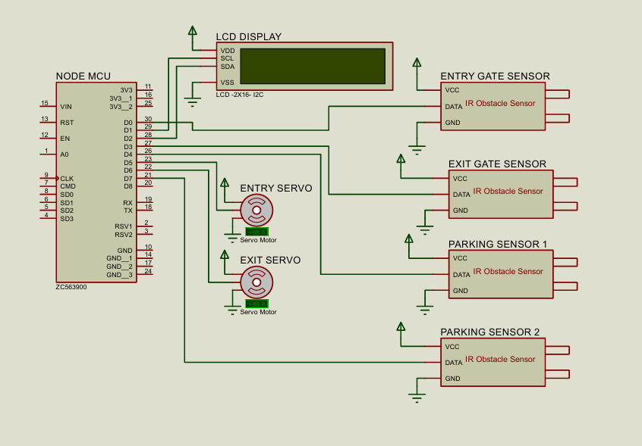
Circuit Diagram

Slide 17
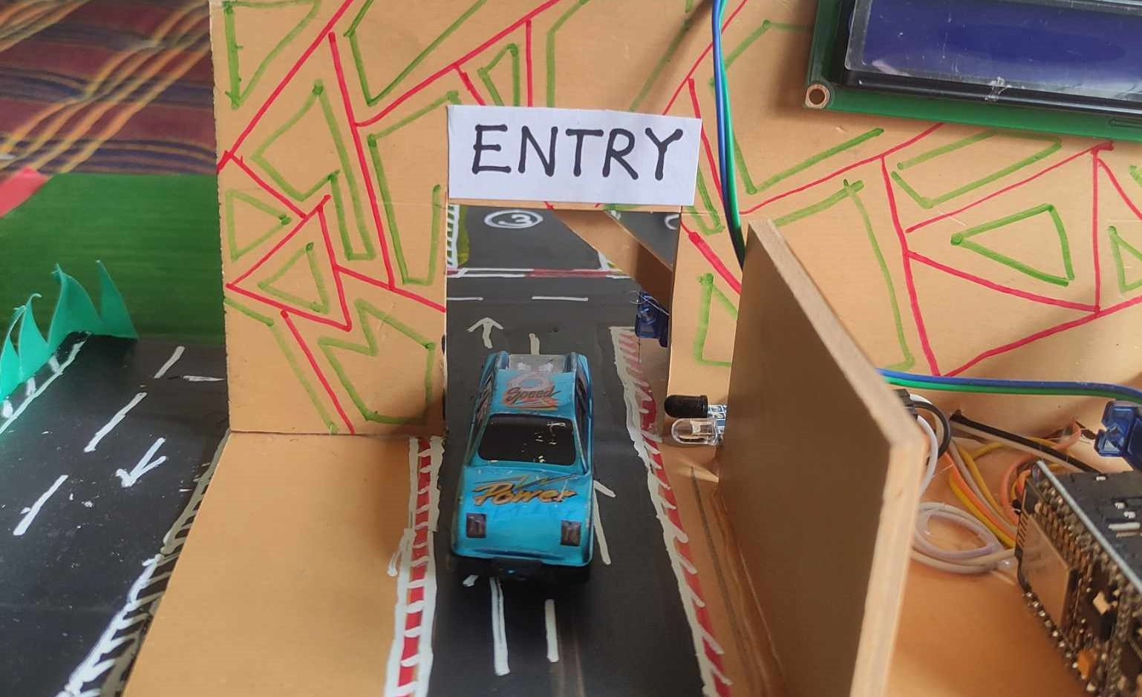
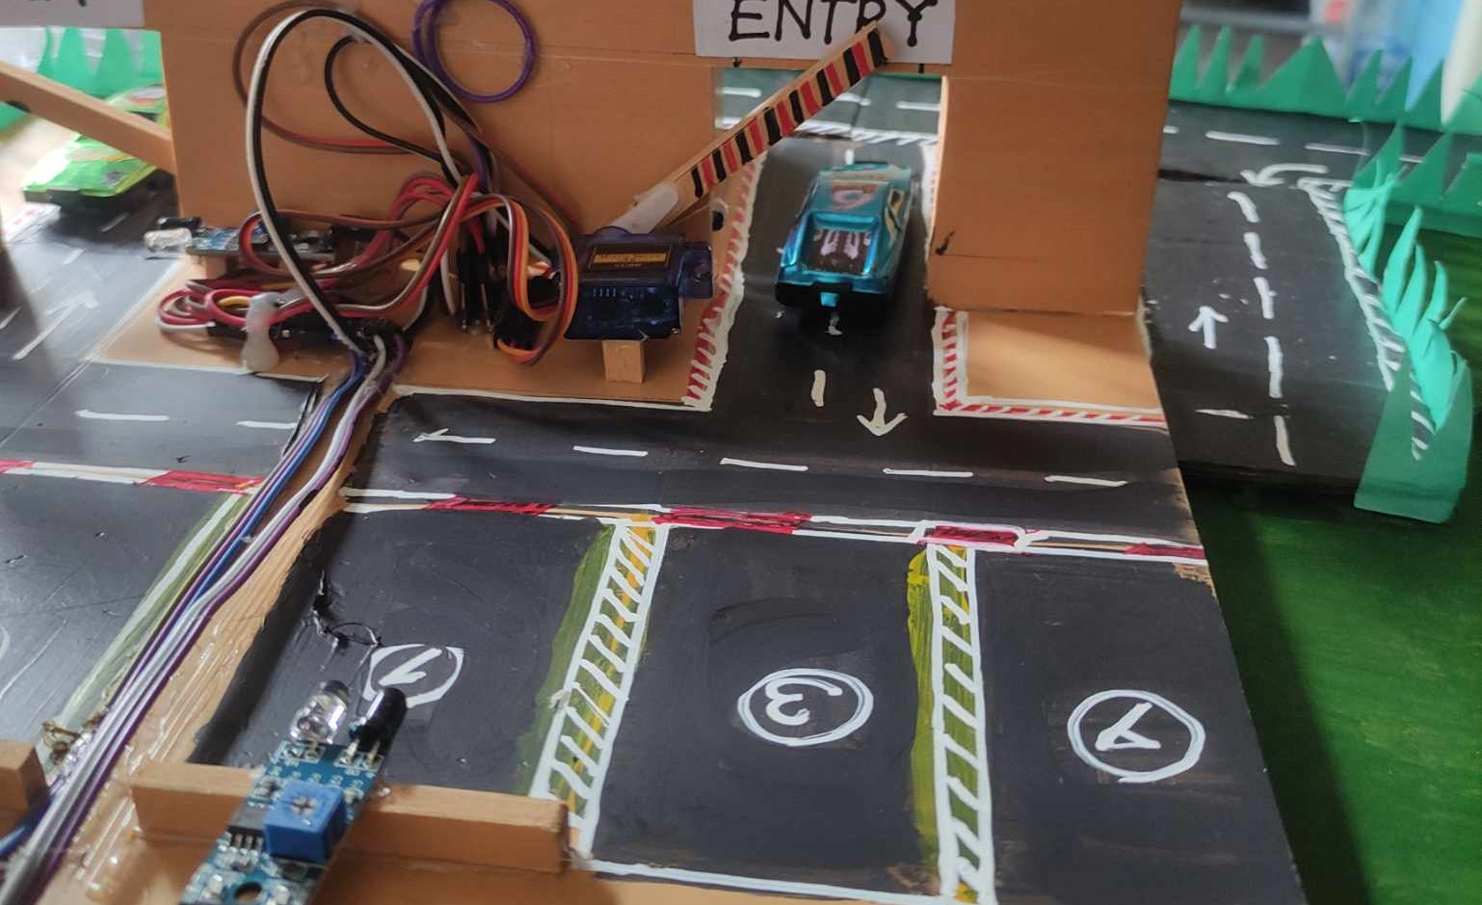
Step 01:
When the car enters the parking area, the IR sensor in Entry Gate will detect the passing vehicle and the entry gate will be opened automatically.

Slide 18
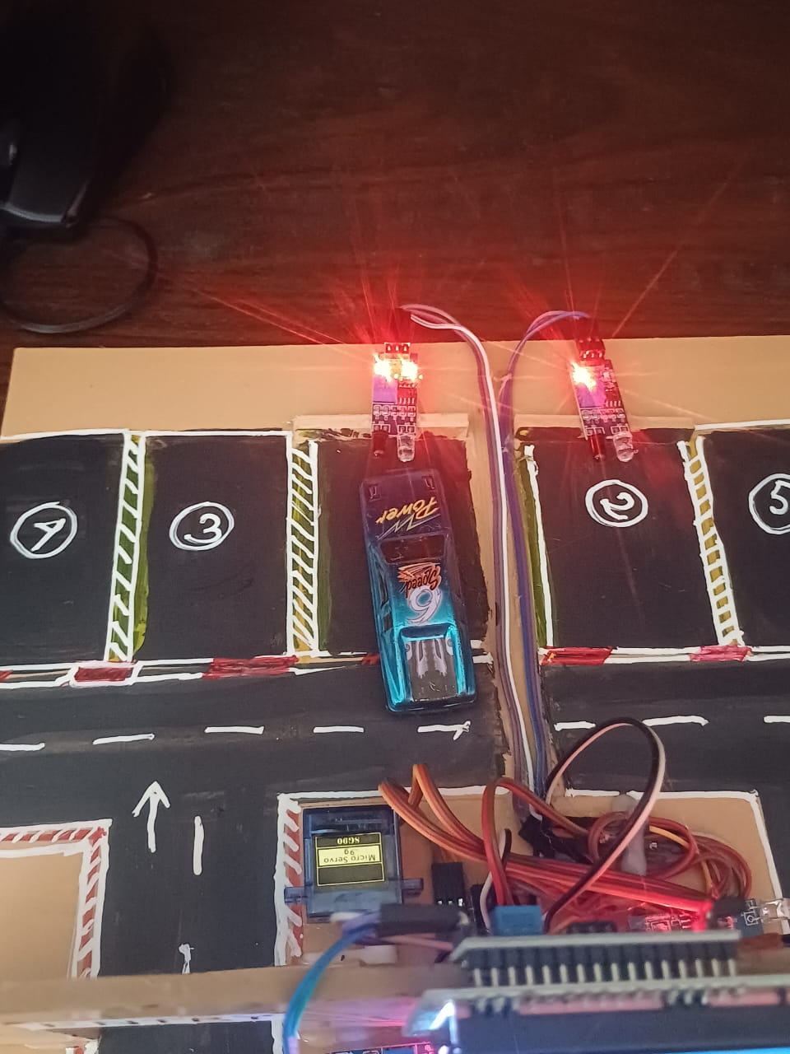
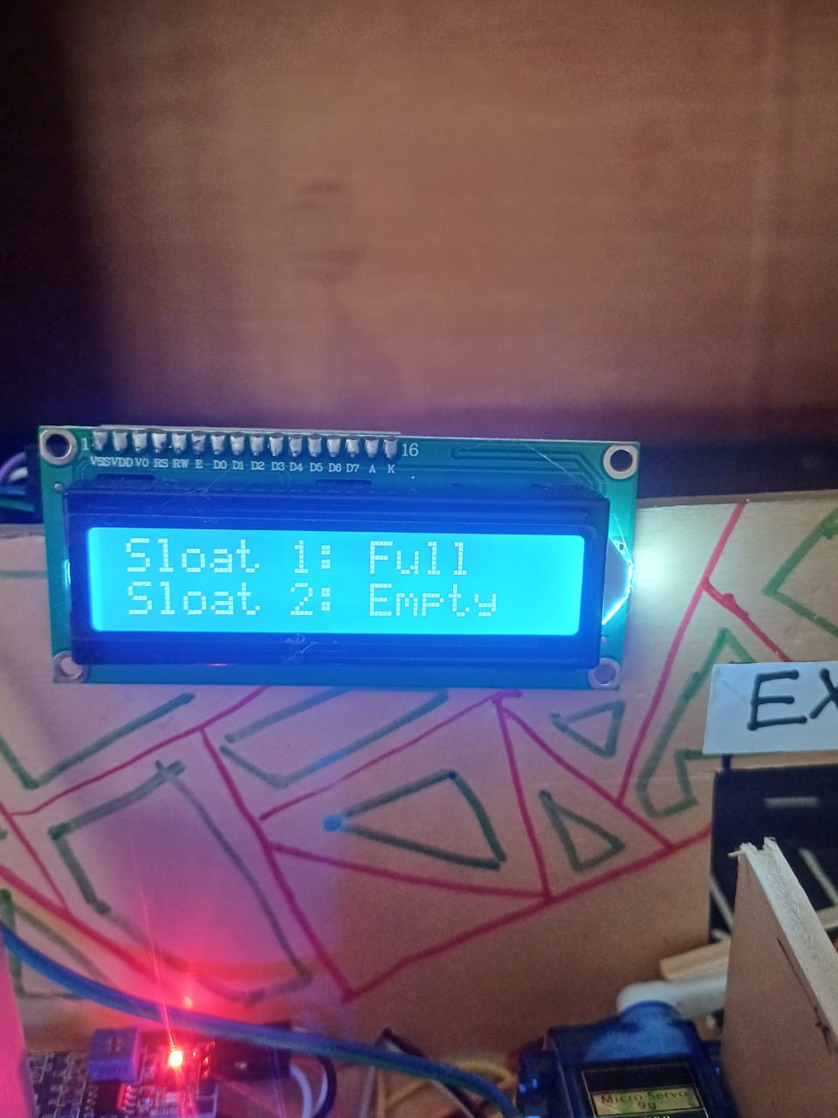
Step 02:
When the car enters the parking slot, the IR Sensor in the slot will detect the car and send slot "FULL" signal to the nodeMCU.

Slide 19
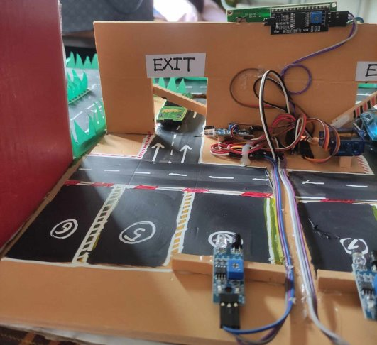
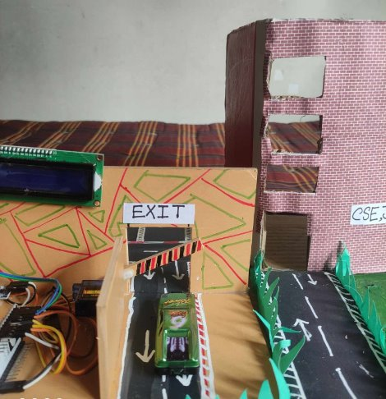
Step 03:
When the car is leaving the parking area, the IR sensor at EXIT Gate will sense the passing car and then sends slots "EMPTY" signal to the nodeMCU. Then the EXIT Gate will be opened automatically.

Slide 20
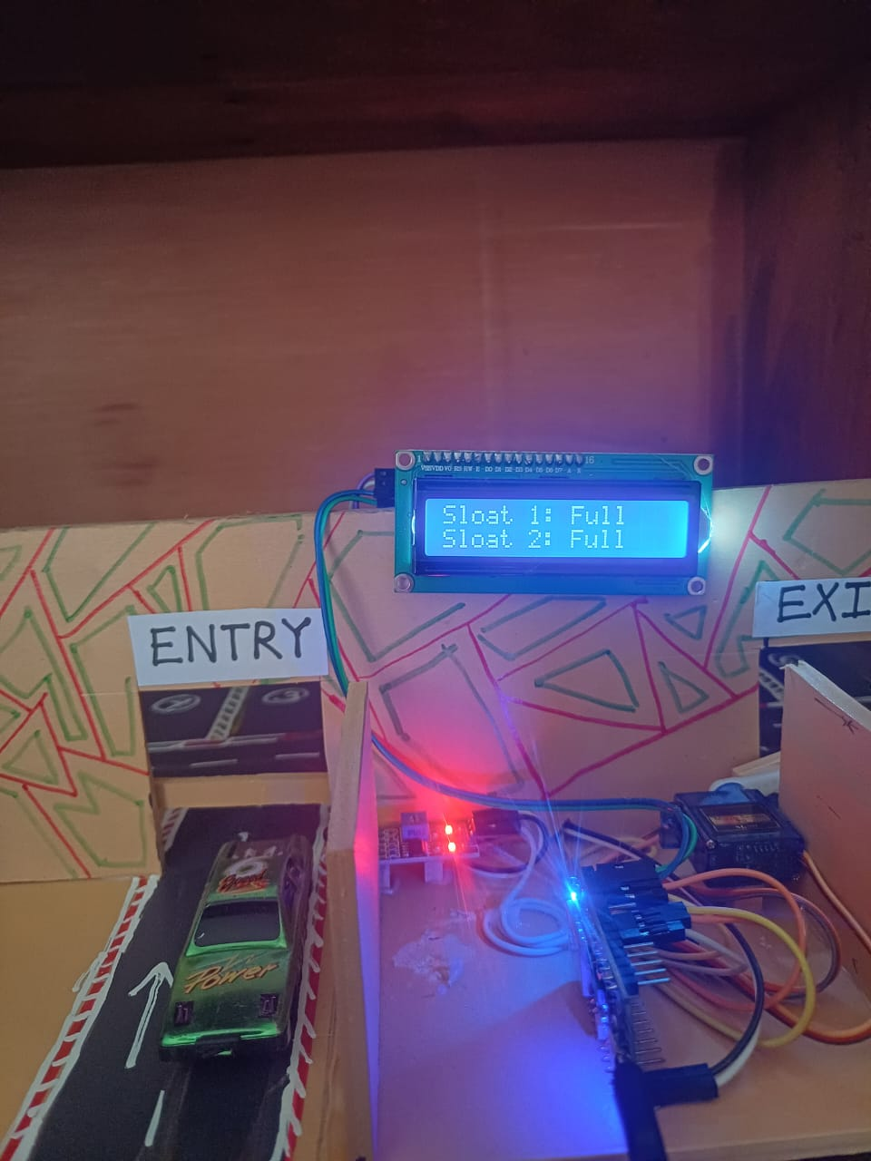
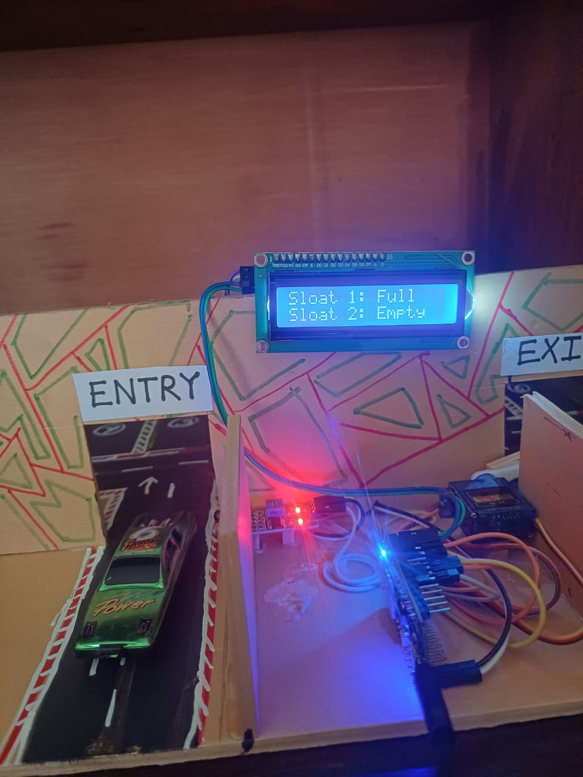
Step 04:
If all the slots are full, then the entry gate will not open unless there is at least an empty slot. The car needs to wait for a while or look for another parking slot.

Slide 21
Step 05:
In front of the parking area there will be an LCD Display which will show the status of the parking slot, whether slot is "FULL" or "EMPTY" .

Slide 22

Step 06:
The main advantage of our system is, the user will register on Blynk website/application.
From this application/website, the user will be able to see the status of the parking area. The application, web dashboard will show the parking status of each slot individually.

Slide 23
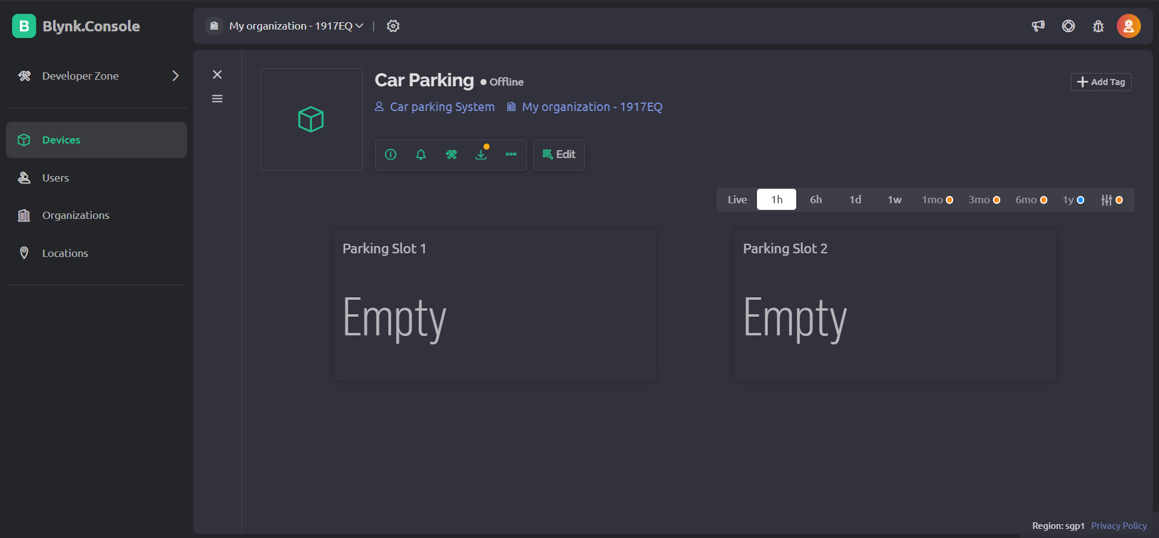
Step 06: (Blynk Web Dashboard)

Slide 24
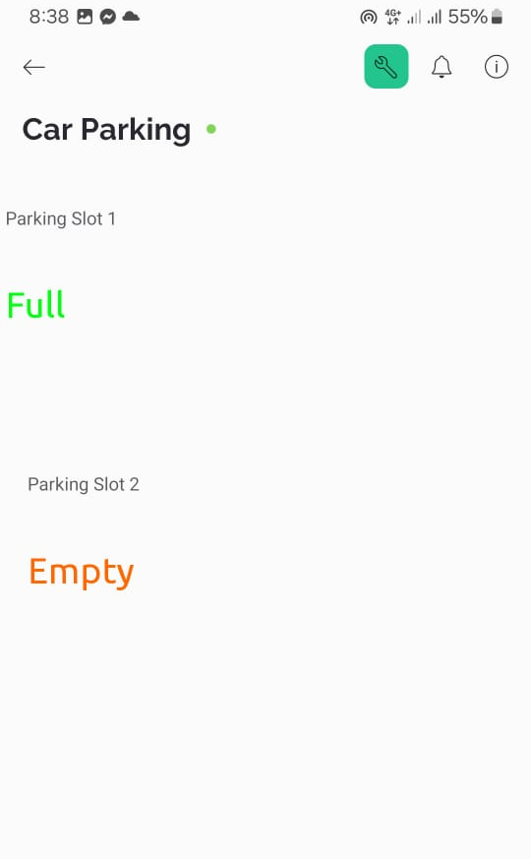
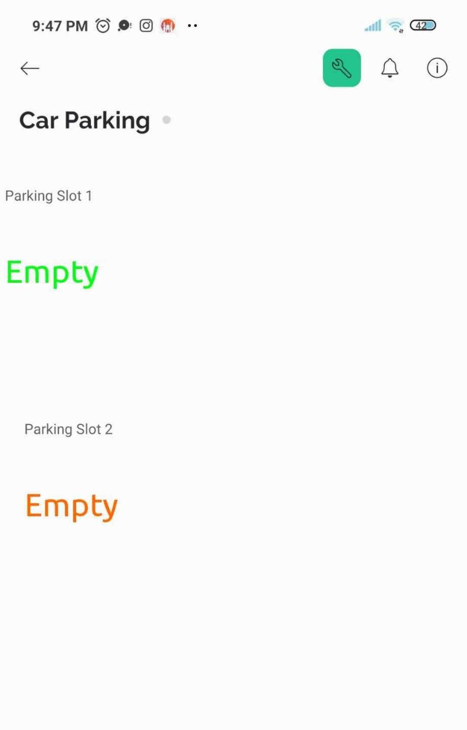
Step 6: (Blynk App Interface)

Slide 25
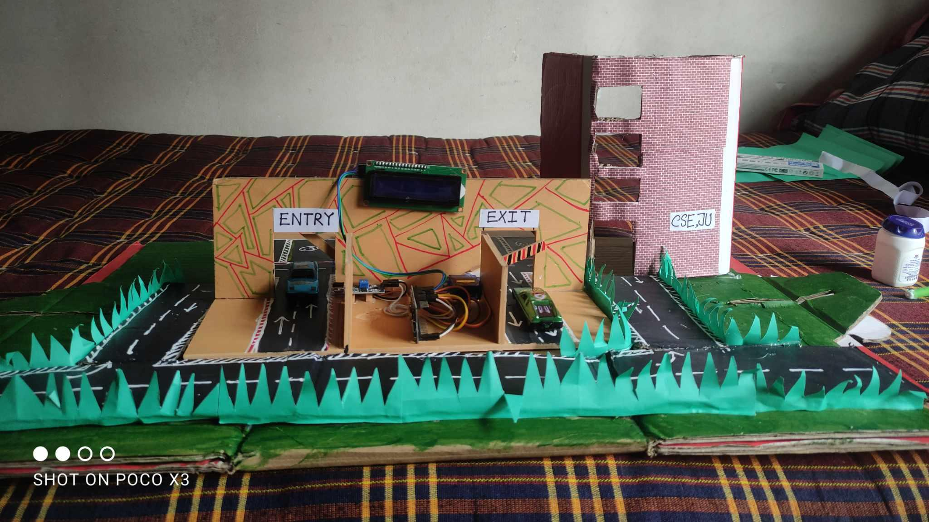
Obtained Output (Front View)

Slide 26
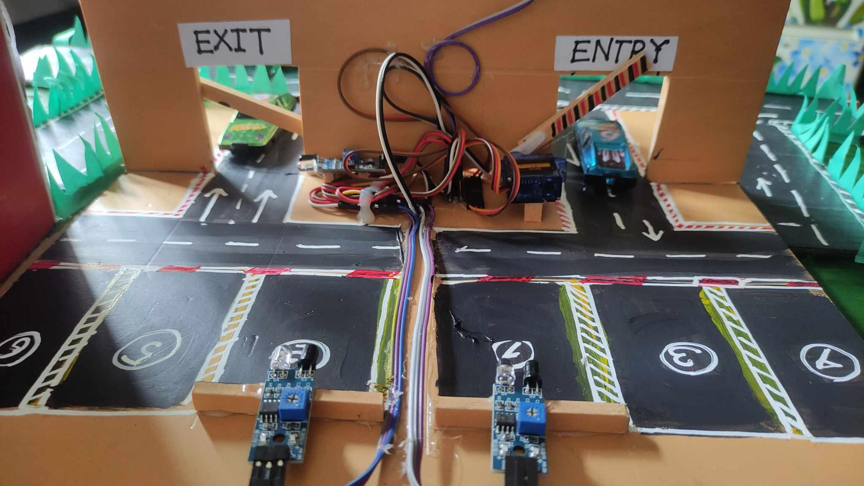
Obtained Output (Back View)

Slide 27
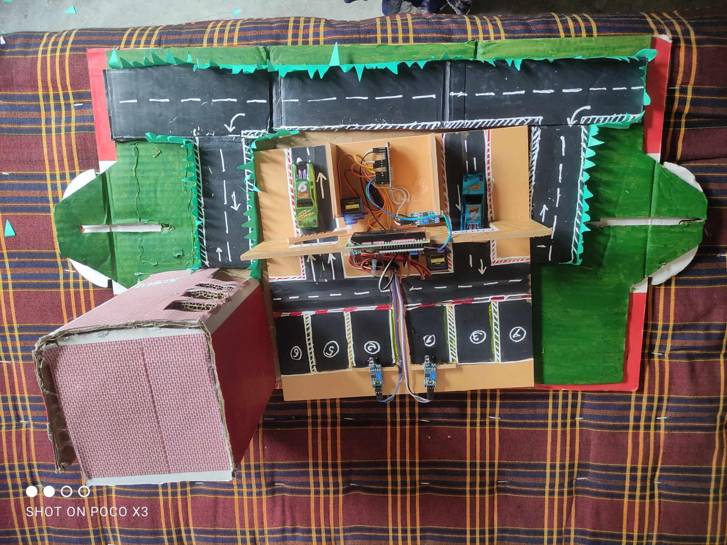
Obtained Output (Top View)

Slide 28
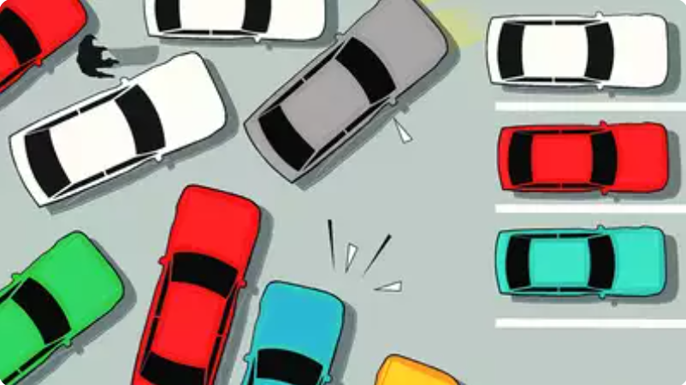
Limitations
In big parking lots, the system may have trouble handling a lot of parking spaces at once.
Environmental factors like direct sunlight may affect IR sensor accuracy.
Security considerations for cloud data storage and remote access need to be addressed.

Slide 29

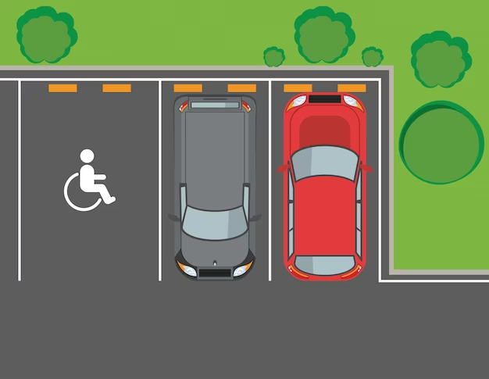
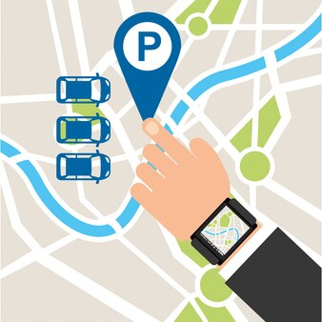

Future Work
Implement an app with a comprehensive map of all parking locations across the university.
Integrate a feature to show the shortest path from the current car location to the nearest empty parking slot.
Develop and integrate a payment system for parking fees within the app.
Develop separate features and parking slots for disabled people.

Slide 30
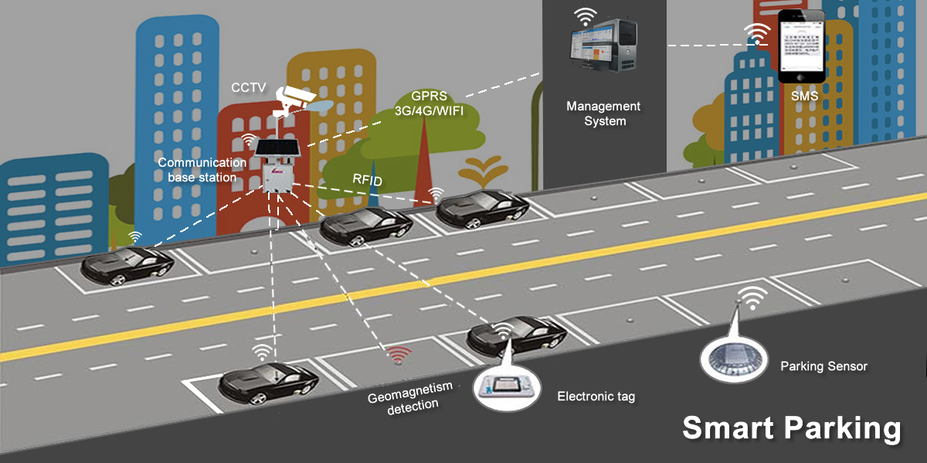
Conclusion
This IoT-based car parking system offers a promising solution to the ongoing parking dilemma.
By using the power of sensors, cloud platforms, app and web interfaces, we can create a smarter and more efficient parking experience for drivers and parking lot operators alike.

Slide 31
References
www.nodemcu.com
iotdesignpro.com
Ultimate Guide to IoT Based Smart Parking System
A. Khanna and R. Anand, "IoT based smart parking system," 2016 International Conference on Internet of Things and Applications (IOTA), Pune, India, 2016, pp. 266-270, doi: 10.1109/IOTA.2016.7562735.
Hardik Tanti , Pratik Kasodariya , Shikha Patel , Dhaval H Rangrej, 2020, Smart Parking System based on IOT, INTERNATIONAL JOURNAL OF ENGINEERING RESEARCH & TECHNOLOGY (IJERT) Volume 09, Issue 05 (May 2020),

Slide 32



Meet Our Team Members
Iffat Ara Sanzida | CSE48
Fariha Rahman | CSE48
Atia Rahman Orthi |CSE48
Jahangirnagar University

Slide 33
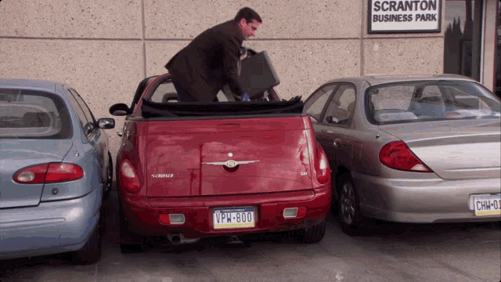
Thank You!
Any Questions?

